Slide 1

ETL Project
Extract, Transform, Load

Slide 2
Extract
CREATE TABLE worldhappinessreport2021(
country VARCHAR,
reginal_indicator VARCHAR,
ladder_score Numeric,
standard_error_of_ladder Numeric,
upperwhisker Numeric,
lowerwhisker Numeric,
logged_gdp_per_capita Numeric,
social_suppor Numeric,
healthy_life_expectancy Numeric,
freedom_to_make_life_choices Numeric,
generosity Numeric,
perceptions_of_corruption Numeric,
ladder_score_in_dystopia Numeric,
dystopia_plus_residual Numeric );
CREATE TABLE HappinessAlcoholConsumption(
country VARCHAR,
region VARCHAR,
hemisphere Numeric,
happinessscore Numeric,
hdi Numeric,
gdp_percapita Numeric,
beer_percapita Numeric,
spirit_percapita Numeric,
wine_percapita Numeric );
CREATE TABLE LifeExpectancy(
countryname VARCHAR,
IndicatorName VARCHAR,
Year_2019 Numeric );
SELECT LE.countryname, HP.HappinessScore,
WH.Healthy_life_expectancy, LE.year_2019,
WH.social_support, WH.Generosity, HP.beer_percapita,
HP.spirit_percapita, HP.wine_percapita
FROM worldhappinessreport2021 as WH
right JOIN HappinessAlcoholConsumption as HP
ON WH.country_name=HP.country
left JOIN lifeexpectancy as LE
ON WH.country_name=LE.countryname
ORDER BY "happinessscore" DESC
We were given the Alcohol and Happiness Project. Finding another data source to bring in was a challenge.
We found a dataset on data.worldbank.org that had life expectancy per country. We then decided to compare the happiness score to life expectancy.
Notes:
Reference for life expectancy csv: https://data.worldbank.org/indicator/SP.DYN.LE00.MA.IN

Slide 3

Transform
In pgAdmin4 we ordered the table by the happiness score
SELECT LE.countryname, HP.HappinessScore,
WH.Healthy_life_expectancy, LE.year_2019,
WH.social_support, WH.Generosity, HP.beer_percapita,
HP.spirit_percapita, HP.wine_percapita
FROM worldhappinessreport2021 as WH
right JOIN HappinessAlcoholConsumption as HP
ON WH.country_name=HP.country
left JOIN lifeexpectancy as LE
ON WH.country_name=LE.countryname
ORDER BY "happinessscore" DESC
In Python we brought the data in and ordered it by happiness score in descending order.
# Load read of Hapiness Score and Length of Life csv join
hp_le_csv = "Resources/Joins HP_LE_WH.csv"
# Read CSV
hp_le_df = pd.read_csv(hp_le_csv)
# Set order by happiness score
hp_le_sort_df = hp_le_df.sort_values("happinessscore", ascending = False)

Slide 4
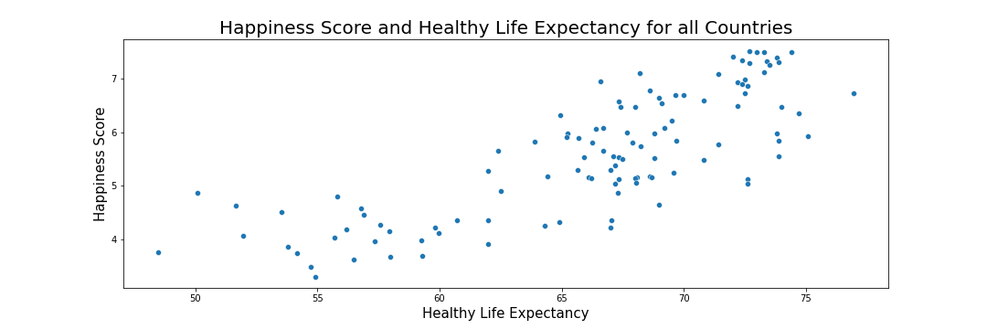
LOAD
Once our new table was in Python we used existing code and created a scatter plot to see the relationship between life expectancy and happiness.

